Slide 1

Stroke Prediction
Team Purple 9 – Khushboo, Sneha, Ning, Srikar, Faraz

Slide 2
Agenda
1.
2.
3.
Data Preprocessing
Project Description
About the Dataset
4.
5.
Model Selection and Evaluation
6.
Data Exploration
Conclusion

Slide 3
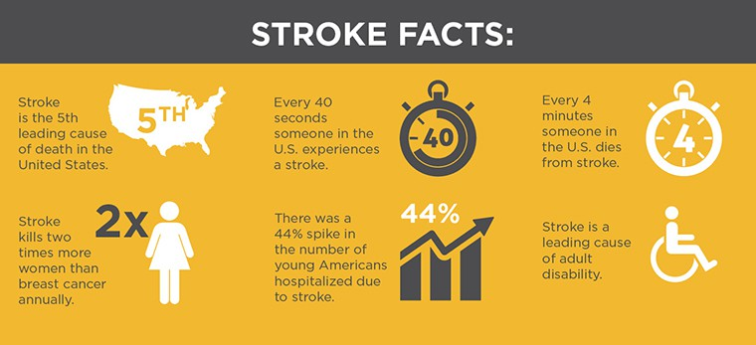
Over 13 million people will have a stroke each year and around 5.5 million people will die as a result.
Fast access to treatment saves lives and improves recovery.

Slide 4

Project Description
Data-based decision making is increasing in medicine because of its efficiency and accuracy.
Different machine learning (ML) models have been developed to predict the likelihood of a stroke occurring in the brain.
Models can predict risk with high accuracy while maintaining a reasonable false positive rate.
This research uses a range of physiological parameters and machine learning algorithms
Numerous model comparisons have established their robustness, and the scheme can be deduced from the study analysis.

Slide 5
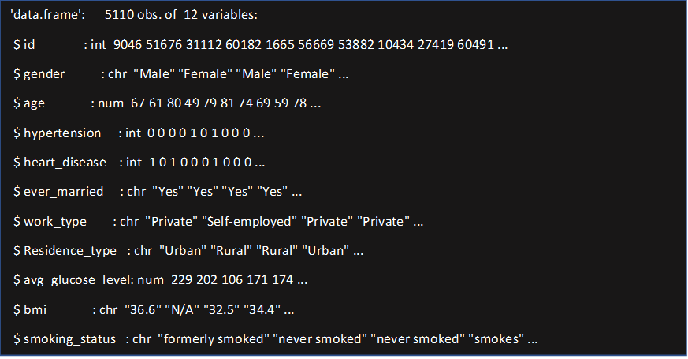
About the dataset
https://www.kaggle.com/fedesoriano/stroke-prediction-dataset - Dataset used
The number 0 indicates that no stroke risk was identified, while the value 1 indicates that a stroke risk was detected.
249 rows alone in the stroke column have the value 1, whereas 4861 rows have the value 0

Slide 6
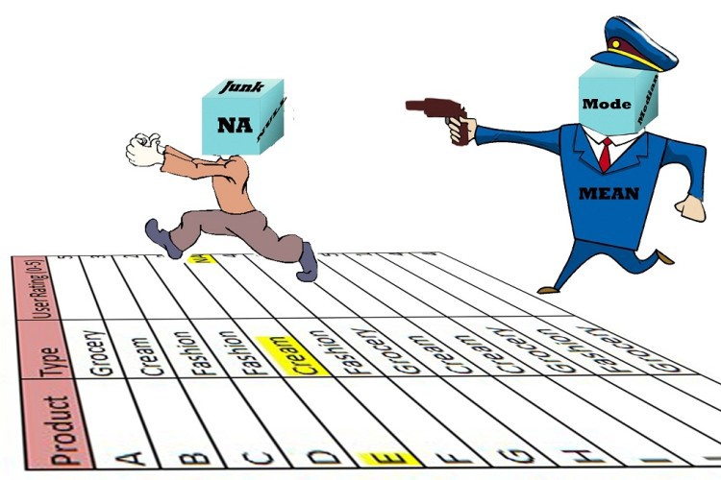
Data Preprocessing
Drop ID column
Identify Null Values
String values converted into categorical representation
Replace null values in BMI with calculated mean values based on age buckets.

Slide 7

Upsampling
In the absence of more real data, Upsampling a minority label is a justifiable approach especially in domains like healthcare and life sciences where data cant be synthesized.
Split the data in 6:4, 60 % Train Data and 40 % Test Data. Training Data is then upsampled using upsample function in CARET library.

Slide 8
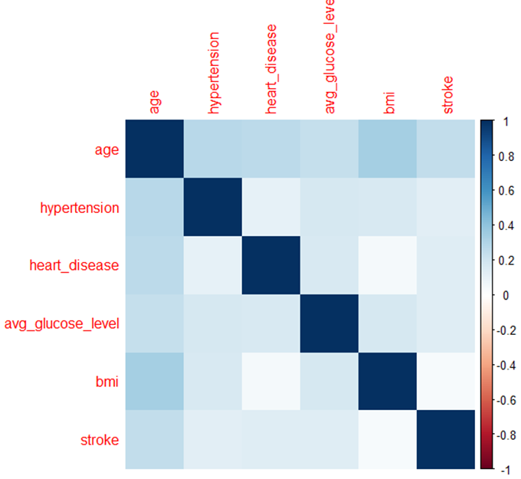
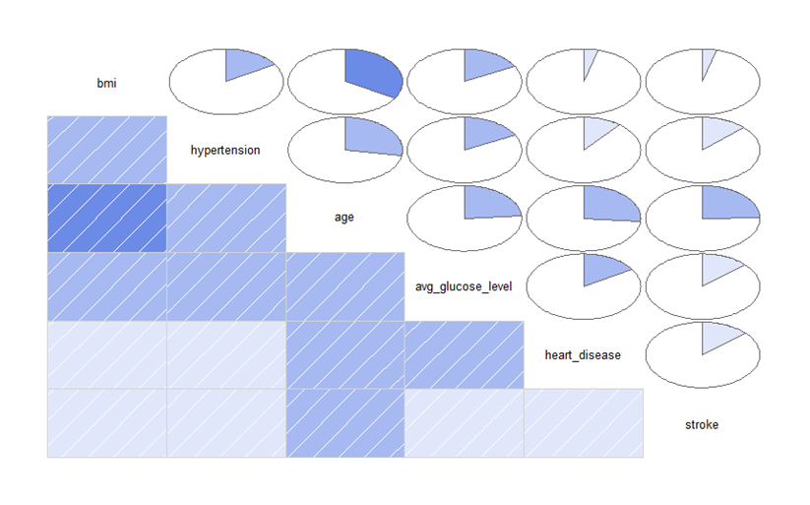
Data Exploration
Correlation between Predictors

Slide 9
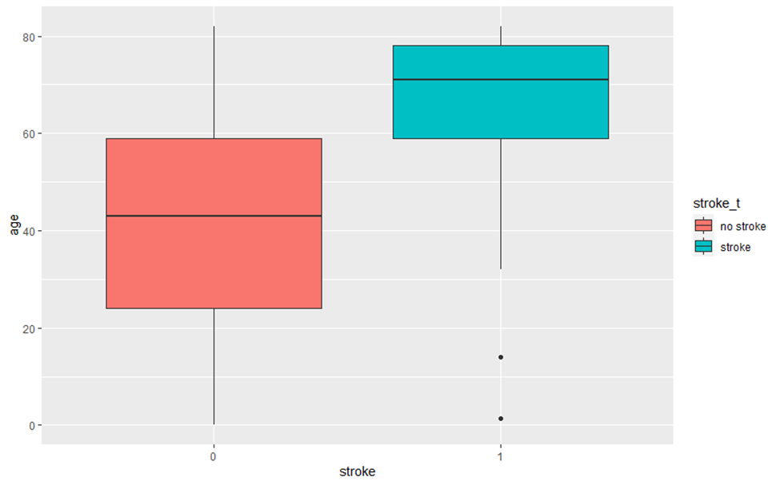
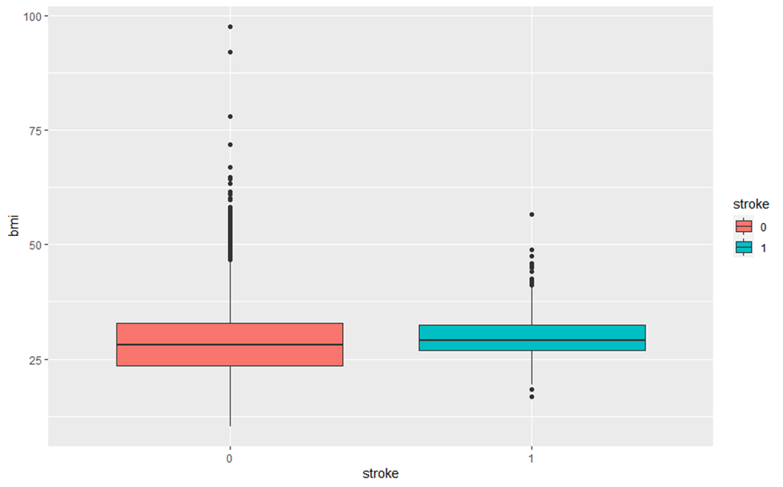
Data Exploration
Age vs Stroke
BMI vs Stroke

Slide 10
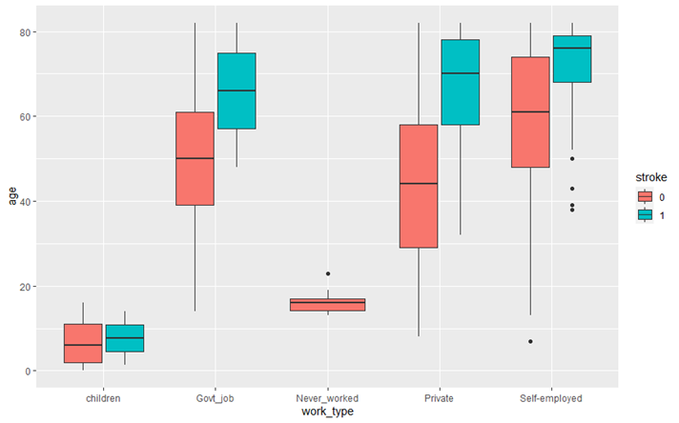
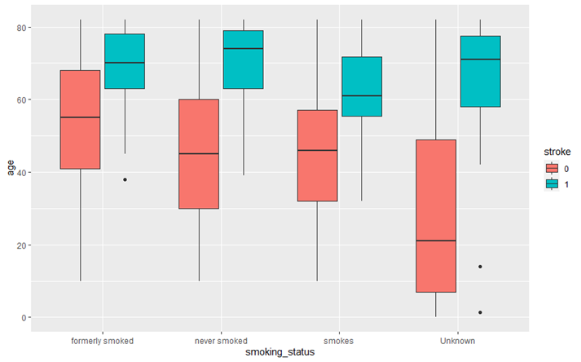
Data Exploration
Work Type vs Stroke
Smoking vs Stroke

Slide 11
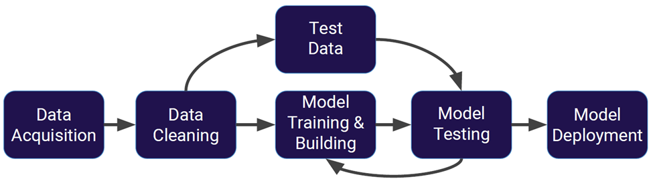
Model Selection
In this research we have used
Logistic Regression
Random Forrest
Neural Networks
A Quick Recap

Slide 12

Logistic Regression
Confusion Matrix |  | Reference
 |  | 0 | 1
Prediction | 0 | 1474 | 14
 | 1 | 490 | 66
Using Logistic Regression we Achieved
Accuracy – 75.34 %
Precision Score – 82.5 %
Recall Score – 75.05 %

Slide 13
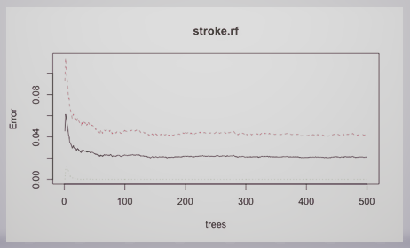
Random Forest
Random forest is a type of supervised learning algorithm
Builds multiple decisions trees and combines predictions from individual models for more accurate results
Takes random predictors for the decisions trees and runs the model
Confusion Matrix |  | Reference
 |  | 0 | 1
Prediction | 0 | 1881 | 84
 | 1 | 66 | 13
Using Random Forrest we Achieved
Accuracy – 92.66 %
Precision Score – 96.61 %
Recall Score – 13.40 %

Slide 14
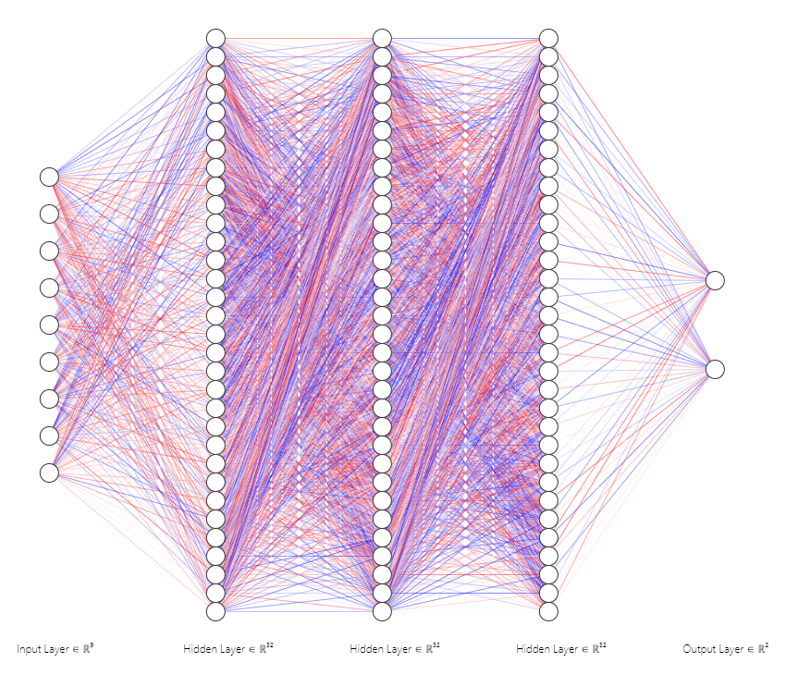
Artificial Neural Networks
Deep Learning Algorithm. Learn and models non-linear and complex relationships
Network of functions to understand and translate predictors of one form into a desired output
We have used the deep learning function from the H20 package to build our ANN Model.
Confusion Matrix |  | Reference
 |  | 0 | 1
Prediction | 0 | 1636 | 43
 | 1 | 294 | 71
Using Neural Networks we Achieved
Accuracy – 83.51 %
Precision Score – 62.28 %
Recall Score – 84.76 %

Slide 15
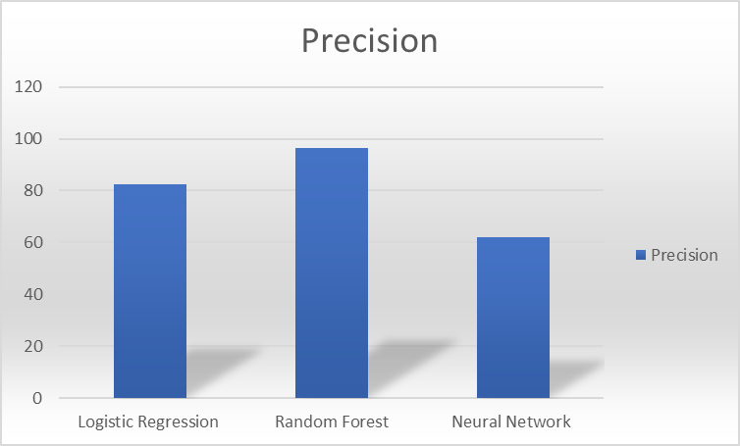
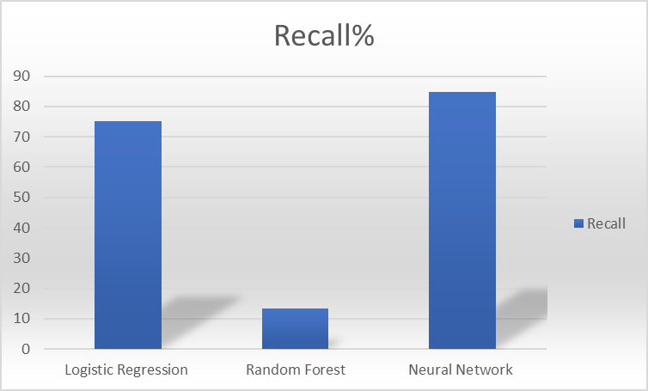
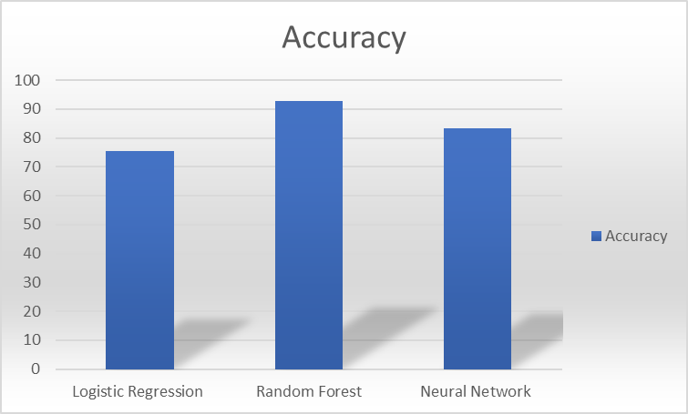
Model Evaluation
Logistic Regression has the highest Recall % in this particular data set making it the efficient algorithm to predict stroke.
Recall% is the most suited comparison in the case of a healthcare industry as it allows to predict the true positives.
In a real-life scenario neural network would perform better depending on the dataset, in this scenario the data set was a small data set with an Up-sampling procedure performed.

Slide 16
Conclusion
Based on the models applied on the current data set we can incur some key observations:
People in the elder age group are more vulnerable to stroke
Significant difference in stroke frequency between groups of people in age of 50-65 with and without heart disease and hypertension.
Factor of smoking need to be investigated in a detailed approach.
People with a male gender were more prone to stroke based on the data observation.

Slide 17
Conclusion
The ability to predict stroke can be a gamechanger, globally over 13 million have stroke each year and around 5.5 million people die of stroke with these numbers going up significantly year on year.
Some key areas for improvement:
There are many other risk factors which influence stroke like tobacco usage, physical inactivity, unhealthy diet, harmful use of alcohol, atrial fibrillation, raised blood lipid level, genetic disposition, and psychological factors.
Access to this data allows the models to be trained better as the influx of other attributes which lead to stroke would help derive further correlations.
An accurate data set in this aspect would allow researchers to further enhance their models and prepare a list of people in real time who might have a high probability of having a stroke in the future.
Access to fast primary response will help reduce the fatality rate in low- and middle-income countries where it is said that two out of three people suffer from a stroke.

Slide 18

Thank You
Please reach out to Team Purple 9 for further queries

